Slide 1
Platooning
EE498 Term Project
Rafet Kavak

Slide 2
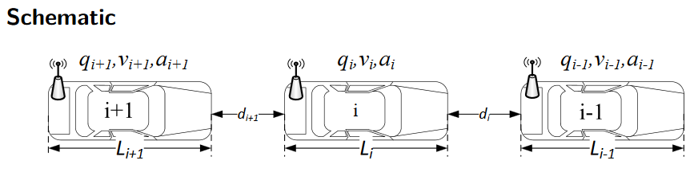
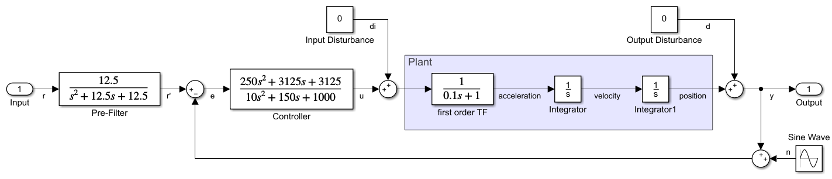
System Model

Slide 3
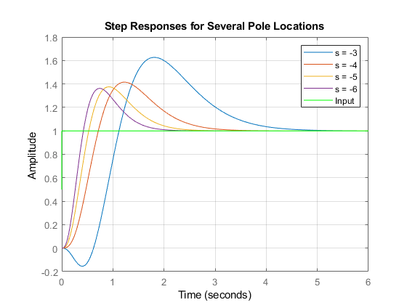
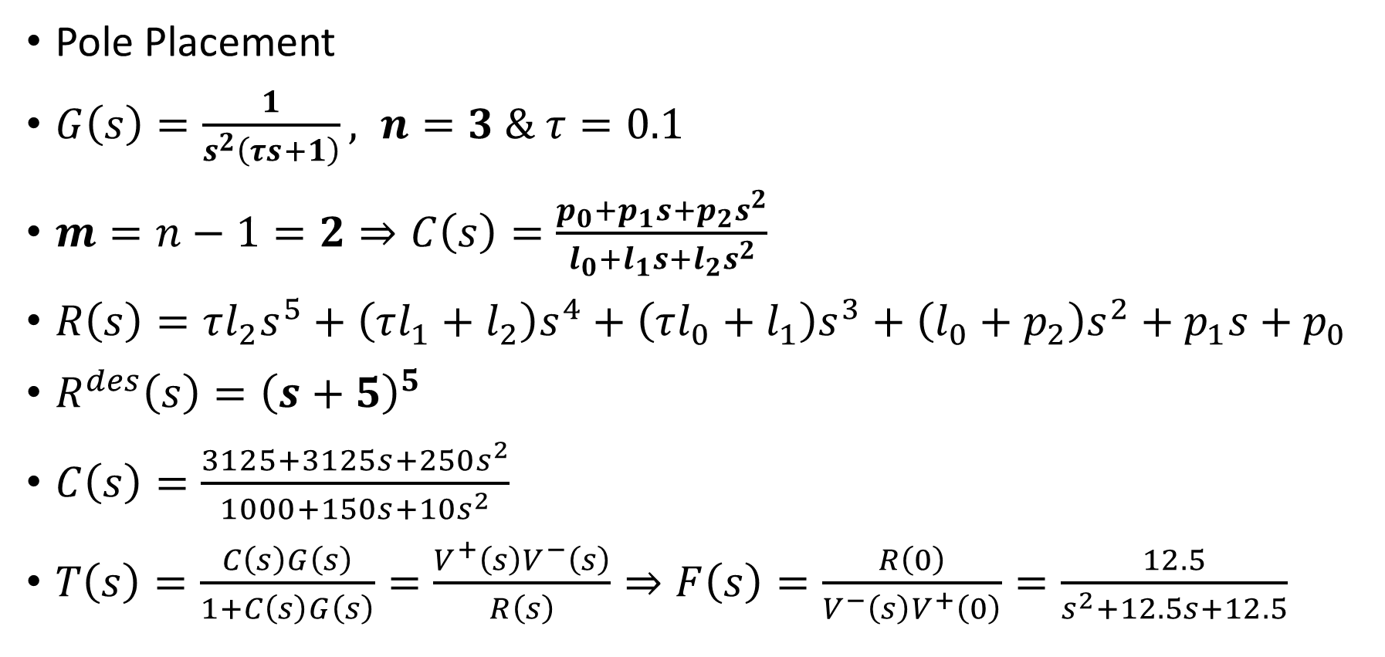
Analysis and Controller Design
Pole Placement
$G\left(s\right)=\frac{1}{s^{2}\left(τs+1\right)}, n=3 \& τ=0.1$
$m=n−1=2⇒C\left(s\right)=\frac{p_{0}+p_{1}s+p_{2}s^{2}}{l_{0}+l_{1}s+l_{2}s^{2}}$
$R\left(s\right)=τl_{2}s^{5}+\left(τl_{1}+l_{2}\right)s^{4}+\left(τl_{0}+l_{1}\right)s^{3}+\left(l_{0}+p_{2}\right)s^{2}+p_{1}s+p_{0}$
$R^{des}\left(s\right)={\left(s+5\right)}^{5}$
$C\left(s\right)=\frac{3125+3125s+250s^{2}}{1000+150s+10s^{2}}$
$T\left(s\right)=\frac{C\left(s\right)G\left(s\right)}{1+C\left(s\right)G\left(s\right)}=\frac{V^{+}\left(s\right)V^{−}\left(s\right)}{R\left(s\right)}⇒F\left(s\right)=\frac{R\left(0\right)}{V^{−}\left(s\right)V^{+}\left(0\right)}=\frac{12.5}{s^{2}+12.5s+12.5}$

Slide 4
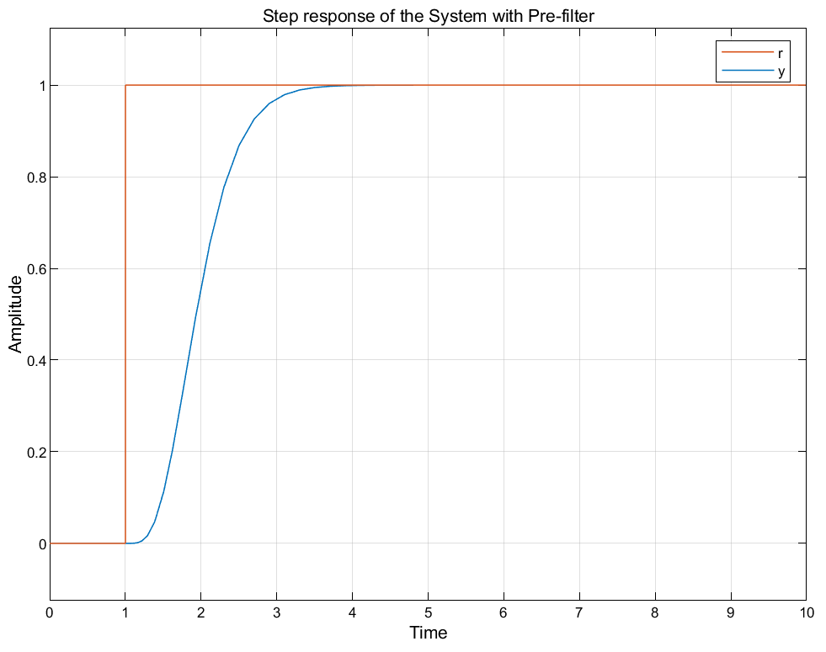
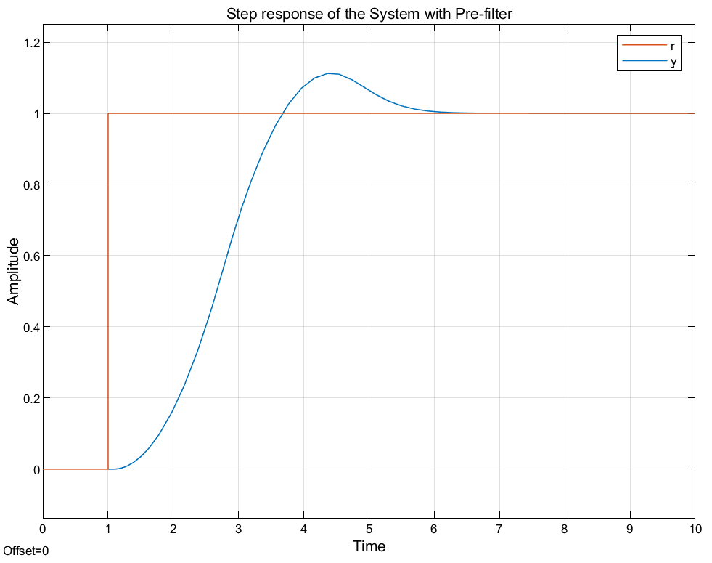
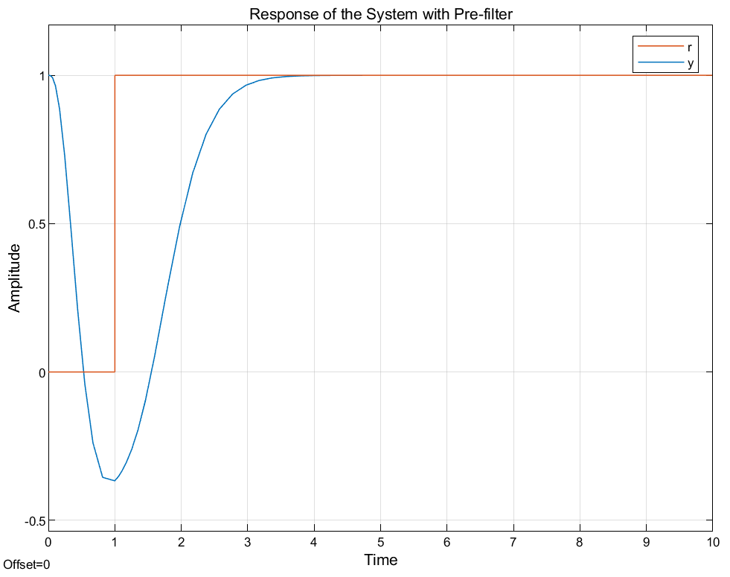
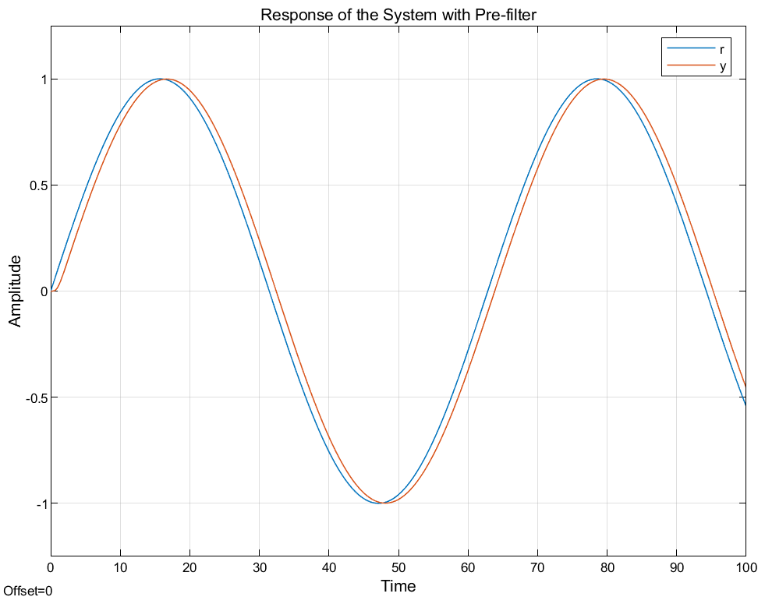
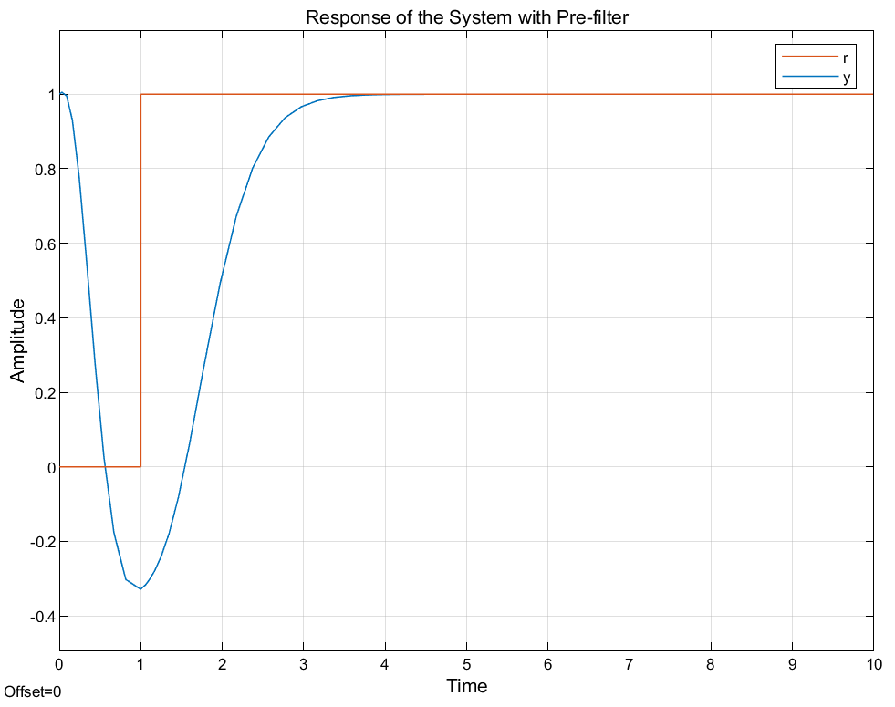
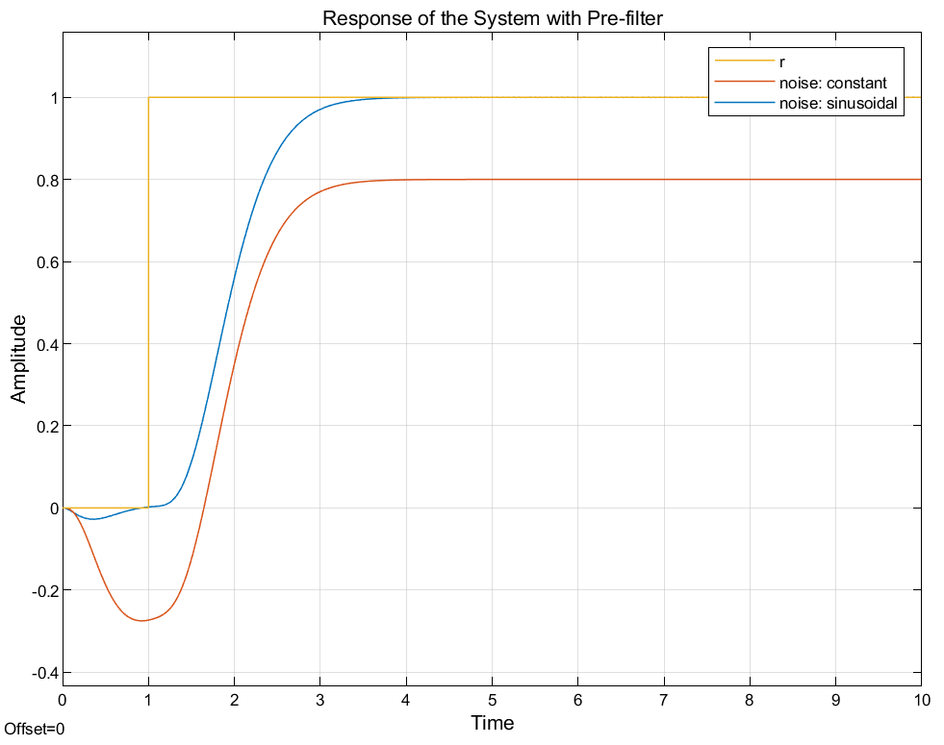
Simulation Results
1
Without disturbances, initial conditions and saturation blocks
3
5
In the presence of saturation blocks
In the presence of output disturbance
Input: Step
Input: Step
Input: Step
2
Without disturbances, initial conditions and saturation blocks
4
6
In the presence of initial conditions
In the presence of noise
Input: Sinusoidal
Input: Step
Input: Step

Slide 5
Main Observations
Overshoot was eliminated with pre-filter.
The system rejects the initial conditions and output disturbance.
The system cannot reject the input disturbance.
The system can reject the sinusoidal noise.
If saturation conditions chosen accordingly, there may no overshoot.
According to pole locations, the system can be faster.

